Slide 1
Dr. Elaine Reedy, Ph.D. Dr. Tommie M. Richardson, MD

Slide 2
Our Mission is Helping People Live Their Best Quality of Life
One Heartbeat at a Time.

Slide 3
R & R’s Self-Care Reset
Consists of Six Modules and Three Subscription Levels.

Slide 4
You Have Subscribed to Level 2 60-Day Self-Care Heart Health and Wellness Reset
Copyright 2023

Slide 5
Level 2
R & R’s Self-Care Reset
Module 1 through 4 are Heart Health Master Classes.
Module 5 and 6 are Master Classes is where we coach you on how to customize and personalize a blueprint to reset your heart’s health and wellbeing.

Slide 6
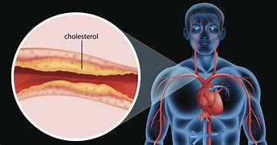
Reset You Your Heart’s Health and Wellbeing Module 1 through 4 Focus on four types of Broken Hearts
Coronary
Artery Disease
(CAD)
High Blood
Pressure
Heart Attack
Stroke

Slide 7
Level 2
Module 5 and 6 Master Classes
Identify and Customize Your Blueprint for Living Your
Best Life!

Slide 8
R & R Self Care Module 5: Identify Your Risk
Know Your Numbers
Identify
Monitor
Prevent

Slide 9
Module 6 Master Class DISH4LIFE
Customize
Personalized
Your Holistic Blueprint

Slide 10
A Tutorial on Know Your Numbers
Patient portals are a resource for accessing your medical records. We coach you on how blood tests are can help you to learn what's happening inside of your body. Your laboratory tests are great tools because it they help you identify, monitor, and prevent risk factors that affect your health.
We are excited to coach on what specific test results mean and how to make lifestyle changes that affect test outcomes and overall wellbeing.

Slide 11
R & R Offers Three Personalized Health Education Master Classes.
Level 2 offers a 60-day personalized master class that is designed for people with no known or low heart health risk factors, or who want a generalized health self-care reset.

Slide 12
R & R Self-Care
Level two and three Subscriptions
Level two: 60-day
Level three: 90- day
Offers advanced health education master classes.
Designed for subscribers who have existing heart health issues or interested in a generalized and comprehensive body reset.
Customized blueprints focus on a healthier heart, mind, body, and spirit!
Customize
Personalized
Your Holistic Blueprint

Slide 13
R & R’s Coaching Platforms are Based on Science and
Backed by Biblical Principles.

Slide 14
Level 2 : 60-Day Self-Care
Level 2 is a 60-day subscription designed for people who have known risk factors for a broken heart.
Level 2 offers a 60-day coaching platform that guides you through a heart health and wellness reset.
The goal of R & R’s coaching platform is to help you customize a self-care heart health reset. The number one cause of death is a broken heart (high blood pressure, stroke, heart attack, plaque in the arteries (CAD), or dying from “ a broken heart”.

Slide 15
Let’s Get Started
The first step is
to complete the electronic
R & R Self-Care Health Assessment.
Don’t forget to return it.

Slide 16
Important Data You Will Log in Your Journal
Blood Pressure
Body Chemistry
Weight
Body Temperature
Lifestyle Habits
Your subscription level will guide you on how often to log your information.

Slide 17
Your Self-Care Journal
The second step is open your electronic journal. Log all requested information in your journal.
We will help you get access to all information needed to build your customizes blueprint, so don’t panic!

Slide 18
Blood Chemistry
Biology
Gender
Family history
Dietary/lifestyle behavior
This information guides us on helping you build a customized and personalized blueprint to follow while on your journey to reset your heart health and live your best life.
During the third step you may discover risk factors that you are not aware of, do not panic. Eighty-five to 90 % of risk factors discovered respond to the holistic intervention and lifestyle changes.
Level 2: 60-Day Self-Care Reset
The third step:
We help you personalize your wellness reset by coaching you on how to collect information about your body’s blood chemistry, blood type, biology, stress responses, family history, and dietary/lifestyle.

Slide 19
Your blood chemistry test results will help us guide you on customizing your personalized self-care reset.
Access your medical records via your medical portal. To your right are examples of existing medical portals.
If you do not have access to your medical portal or blood tests, look for the link to Life Extension to get a lab tests for
35 dollars or less!
Patient Portals
Emory Patient Portal
Kaiser Permanente
Piedmont Patient Portal
Online Access (Life Extension )

Slide 20
Level 2
Measure your blood pressure and weigh yourself
Twice a week
over your 60-day self-care heart health and
wellness reset.

Slide 21
How to take your blood pressure.
Sit in a chair with the back
straight and feet flat on the floor.
Rest for 10 minutes before you take your blood pressure.
Record your blood pressure readings in your journal.

Slide 22
View Module 2 on blood pressure presented by
Dr. Tommie Richardson, MD.
According to the American Heart Association, a healthy blood pressure is 120/80 or less.
What is your blood pressure?
Log your numbers!

Slide 23
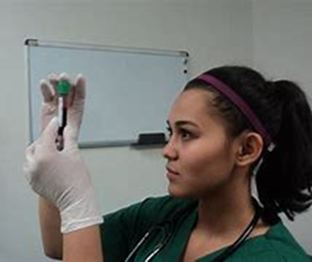
Level 2
Know Your
Blood Chemistry Numbers.
Your blood chemistry test will have numbers needed to build your customized
60-Day Self-Care Reset.
Life Is In The Blood

Slide 24
Level 2
60-Day Heart Health Reset
Your Blood is a Window to Your Inside Health.
The following slides list the blood chemistry tests that can help identify risk factors and guide you on building your customized blueprint for living your best life!

Slide 25
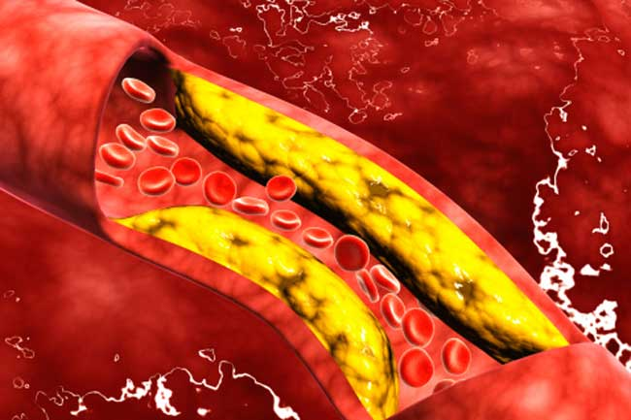
Measure Your Risk Factors
for a Broken Heart
Life is in the flow of blood
Cholesterol
Triglycerides
Low HDL
High LDL

Slide 26
Common Risk Factors that Cause a Broken Heart.
Cholesterol
Log your number in your journal.

Slide 27
Level 2
Inside Your Heart Matters
Coronary Artery Disease (CAD)
Blocks the Arteries
20.1 million adults aged 20 and older have CAD.
2 in 10 deaths are linked to CAD
You or Someone You Know is at Risk.
Cholesterol

Slide 28
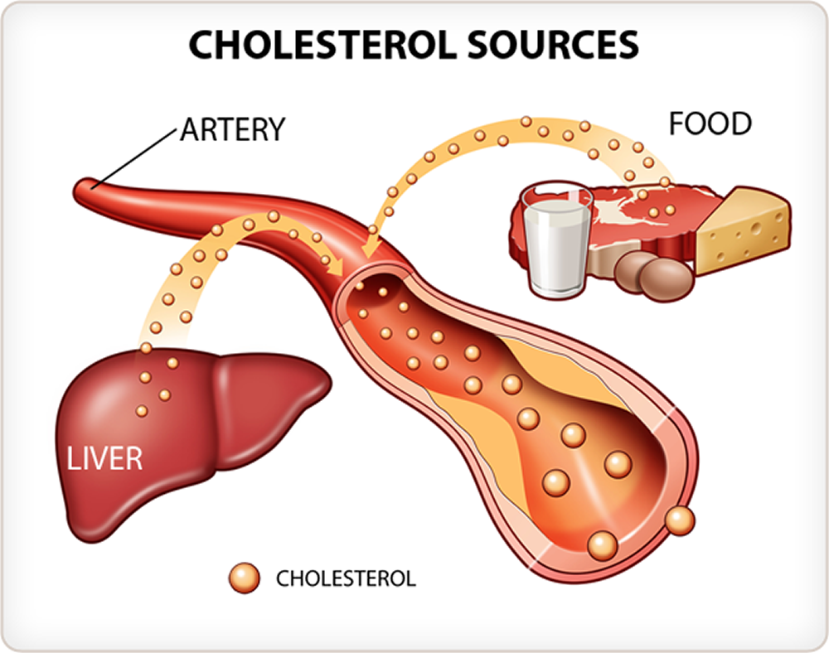
Level 2
60-Day Heart Health Reset
Manage Cholesterol
Atherosclerosis
Harding of the Arteries as a Result of Plaque.
Saturated Fats
Cholesterol can form sticky plaques inside artery walls, which obstruct the flow of blood and oxygen through the body.
Causes coronary artery disease, a risk factor for a broken heart.

Slide 29
Level 2
60-Day Heart Health Reset
Manage Cholesterol
Cholesterol levels vary by race and ethnicity as well as gender.
CDC, 2019.
Black Americans have a higher risk for CAD compared to non-Hispanic white women.

Slide 30
Level 2
60-Day Heart Health Reset
What are the worst foods for high cholesterol?
The following cholesterol-rich foods are high in saturated fat and should be avoided support health.
Full-fat dairy like whole milk, butter and full-fat yogurt and cheese
Red meat such as steak, beef roast, ribs, pork chops and ground beef
Processed meats, especially bacon, sausage and hot dogs
Fried foods like French fries, fried chicken with skin and other foods fried in a deep fryer
Baked goods and sweets including cookies, cakes and doughnuts

Slide 31
Another Common Risk Factors that Cause a Broken Heart.
Low density Lipoprotein
(LDL)

Slide 32
Low-Density Lipoprotein (LDL)
A Risk Factor for a Broken Heart
Keeping the bad Fat Low
Nearly three out of every 10 people in the United States have high LDL cholesterol level of 130 mg/dL or higher).

Slide 33
Low-Density Lipoprotein (LDL)
Keeping the bad Fat Low
The LDL cholesterol makes up most of your body’s cholesterol.
High levels of LDL cholesterol raise your risk for heart disease and stroke by causing the arteries to narrow because of plaque and become inflamed and stiff.

Slide 34
Level 2
60-Day Heart Health Reset
lifestyle behaviors and health disorders can raise LDL cholesterol.
Obesity
Poor dietary habits, especially one high in saturated fat and trans fat.
Low Fiber Intake
Smoking
Physical inactivity

Slide 35
Level 2
60-Day
Heart Health Reset
Family history of high cholesterol
Age (high cholesterol is most common in those ages 40–59)
Type 2 diabetes
Hypothyroidism
Anabolic Steroids
Prednisone
Beta Blockers (in certain people).

Slide 36
CON’T.
Level 2
60-Day Heart Reset
High Density Lipoprotein (HDL)
The Good Fat
HDL absorbs cholesterol in the blood and carries it to the liver. The liver then flushes it from the body. High levels of HDL cholesterol can lower your risk for heart disease and stroke.

Slide 37
CON’T.
Level 2
60-Day Heart Health Reset
Triglycerides
Triglycerides are a type of fat in your blood that your body uses for energy.
The combination of high levels of triglycerides with low HDL and/or high LDL cholesterol levels can increase your risk for a broken heart.

Slide 38
Log Your Immune Health
In your blood test there is a
section called the CBC. It consist of the following. Please log your numbers in the journal.
White Blood Cells (WBC)
Red Blood Cells (RBC)
Hemoglobin
Hematocrit
Platelet
Iron

Slide 39
Review
Congratulation, you have completed your first milestone.
Check List:
R & R Health Assessment
Journal (logging your health stats).
Know your numbers.
Know your risks.

Slide 40
Welcome to Your Second Milestone
Now that you know your risk factors, we help you build your customized holistic blueprint. It will guide you on your journey to living your best heart health life!

Slide 41
Welcome to DISH4LIFE

Slide 42
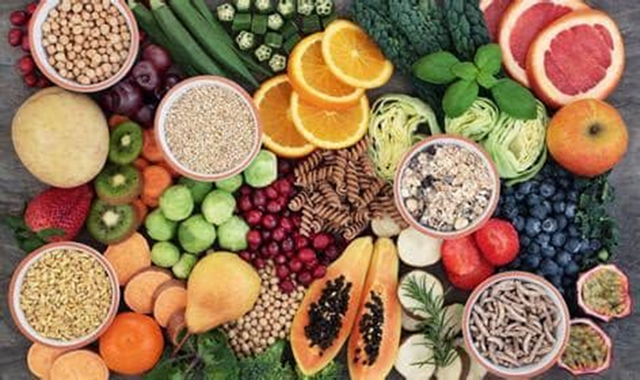
Live or Die Eating
Now that you have logged-in your personal data, we will coach you on how to begin customizing your holistic blueprint to guide you through your 30-day heart health reset.

Slide 43
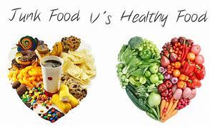
Your Quality of Health is Influenced By What You Put in Your Mouth and How Your Digestive System Processes What You Eat

Slide 44
The American diet is a diet to die by!

Slide 45
DISH4LIFE Is your personal guide for living your best heart health life.
Terms to log in you journal:
Antioxidants
Free Radicals
Fiber
Micronutrients
Macronutrients

Slide 46
Your Personal Guide for Living Your Best Heart Health Life.
Anti-oxidants
A heart health reset should include a rich source of
antioxidants.
Why?
As we age, body parts (organs) and our plumbing system (circulation) gets rusty and stiff. Often this process is accelerated by a diet and a low antioxidant diet. To prevent and reverse the rate of aging of our body parts, the body needs antioxidants.

Slide 47
Your Personal guide for living your best heart health life.
Anti-oxidants
Antioxidants are molecules that help your body fight off harmful free radicals are linked to:
Heart disease
Diabetes
Arthritis
Inflammatory diseases
Hormonal imbalance
Cancer

Slide 48
Your Personal Guide for Living Your Best Heart Health Life.
Anti-oxidants vs. Free Radicals
Now is the perfect time to reverse accelerated/premature aging by eating foods that help build a healthy shield that protects the body from free radicals.

Slide 49
Your Personal Guide for Living Your Best Heart Health Life.
Anti-oxidants
You may have heard a lot of talk about antioxidants.
However, few people know what they are or how they work.

Slide 50
Your Personal Guide for Living Your Best Heart Health Life.
Anti-oxidants
Are you eating enough antioxidants?

Slide 51
Your Personal Guide for Living Your Best Heart Health Life.
Free Radicals
Are you eating enough antioxidants to
manage free radicals?

Slide 52
Your Personal Guide for Living Your Best Heart Health Life.
Free radicals have a lifespan of only a fraction of a second, but during that time can damage DNA, sometimes causing mutations that can increase your risk of getting health conditions like heart disease and cancer.
Free radicals can also be made by the body after exposure to:
Toxins in the environment
Tobacco smoke
Ultraviolet (UV) light
Herbicides and pesticides

Slide 53
Your Personal Guide for Living Your Best Heart Health Life.
During your 30-day heart health reset, we will coach you on how to protect your body from rusting prematurely from over production of free radicals, lower your risk to a broken heart, reduce risk factors that cause inflammation, and poor circulation.
In the master class we teach you how to use food to heal and protect the body.

Slide 54
Your Personal Guide for Living Your Best Heart Health Life.
60-Day Heart Health Reset
Increase Your Antioxidant Intake

Slide 55
Your Personal Guide for Living Your Best Heart Health Life.
Add the antioxidant foods listed below to your diet.
Antioxidants come from whole foods, do not eat any processed foods during the rest phase.
View our videos our DISH4LIFE educational videos. From the comfort of your home and in your kitchen, you can learn one-on-one how to make nutritiously rich and delicious meals, snacks, and smoothies.

Slide 56
Your Personal Guide for Living Your Best Heart Health Life.
Included in your subscription you have access to many recipes that you can prepare.
You must take time for self-care. When you eat to live you are making a self-deposit. Life can get so hectic that we forget to take care of our body or make self deposits through giving self-care.

Slide 57
Let’s Get Started
60-Day Reset

Slide 58
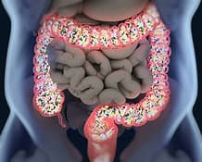
Step One
Reset Your Digestive System
Cleansing
Tonifying
Repopulating Healthy Microflora

Slide 59
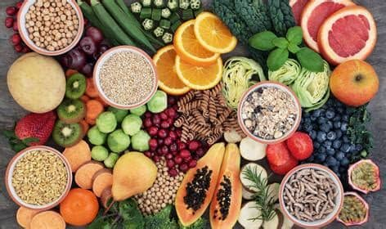
Step One
Cleansing with Fiber
If you are like most people, you do not eat enough fiber rich foods daily.
We help you cleanse your gut with fiber. Fiber has many health benefits.

Slide 60
Gut Cleansing and Nurturing with Fiber
Fiber is commonly classified as soluble, which dissolves in water, or insoluble, which doesn't dissolve in water.
Soluble fiber. This type of fiber dissolves in water to form a gel-like material. It can help lower blood cholesterol and glucose levels. Soluble fiber is found in oats, peas, beans, apples, citrus fruits, carrots, barley and psyllium.
Insoluble fiber. This type of fiber promotes the movement of material through your digestive system and increases stool bulk, so it can be of benefit to those who struggle with constipation or irregular stools. Whole-wheat flour, wheat bran, nuts, beans and vegetables, such as cauliflower, green beans and potatoes, are good sources of insoluble fiber.

Slide 61
Soluble Fiber
Soluble fiber provides the following benefits:
Fiber bulks within the colon and scrubs the walls to remove toxins and supports hydration in the colon.

Slide 62
Soluble Fiber
Fiber Lowers LDL cholesterol in the blood by affecting how the body absorbs fats such as trans-fats, cholesterol, LDL, saturated fats.

Slide 63
Soluble Fiber
Fiber slowing absorption of other carbohydrates through digestion, which can help regulate blood sugar levels

Slide 64
Soluble Fiber
Good sources of soluble fiber include:
Beans
Fruits
Oats
Nuts
Vegetables

Slide 65
Insoluble Fiber
Good sources of insoluble fiber include:
Fruits
Nuts
Vegetables
Whole Grain Foods

Slide 66
Eat More Fiber
Do healthy bowels float or sink?
Fiber Normalizes bowel movements.
Fiber increases the weight and size of your bowel and softens it which support regularity. A bulky bowel stool is easier to pass and sinks to the bottom. On the other hand, low fiber intake cause the stool to float.

Slide 67
Low Fiber Intake
According to surveys, about 5% of the population meet the adequate intake recommendations.
Most people who eat the standard American, perhaps, including yourself, are not eating the recommended grams of dietary fiber.

Slide 68
Fiber
Several studies over the past several decades have examined dietary fiber’s effect on heart health, including preventing cardiovascular disease and reducing blood pressure.
Studies found that people who ate a high fiber diet had significantly reduced risk of cardiovascular disease, better blood pressure control, and lower mortality.

Slide 69
What is Your Fiber Intake?
Count how many grams of fiber you eat daily. Are you eating enough?
Use the fiber food list to build your dietary fiber intake.

Slide 70
Recommended Fiber Intake
According to the Academy of Nutrition and Dietetics, the recommended intake for dietary fiber in a 2,000 calorie diet is:
25 grams (g) per day for adult females
38 g per day for adult males.
Dietary fiber intake can be estimated at 14 grams per 1,000 calories of food. For example, at a 2,000-calorie reference level (which is appropriate for some but not all people) the daily dietary fiber would be 28 grams.

Slide 71
Fiber Food Sources
Food | Serving size | Calories | Dietary fiber in g
High fiber bran (ready-to-eat cereal) | ½–3/4 of a cup | 60–81 | 9.1–14.3
Chickpeas, canned | 1/2 a cup | 176 | 8.1
Lentils, cooked | 1/2 a cup | 115 | 7.8
Pinto beans, cooked | 1/2 a cup | 122 | 7.7
Black beans, cooked | ½ a cup | 114 | 7.5
Lima beans, cooked | 1/2 a cup | 108 | 6.6
White beans, canned | ½ a cup | 149 | 6.3
Kidney beans | 1/2 a cup | 112 | 5.7
Wheat bran flakes (ready-to-eat cereal) | 3/4 of a cup | 90–98 | 4.9–5.5
Raw pear | 1 medium fruit | 101 | 5.5
Baked beans, canned, plain | 1/2 a cup | 119 | 5.2
Avocado | 1/2 a cup | 120 | 5.0

Slide 72
Fiber Sources
Mixed vegetables, cooked from frozen | 1/2 a cup | 59 | 4.0
Raspberries | ½ a cup | 32 | 4.0
Blackberries | 1/2 a cup | 31 | 3.8
Collards, cooked | 1/2 a cup | 32 | 3.8
Sweet potato, baked in skin | 1 medium vegetable | 103 | 3.8
Popcorn, air-popped | 3 cups | 93 | 3.5
Almonds | 1 ounce (oz) | 164 | 3.5
Whole wheat spaghetti, cooked | 1/2 a cup | 87 | 3.2
Orange | 1 medium fruit | 69 | 3.1
Banana | 1 medium fruit | 105 | 3.1
Oat bran muffin | 1 small muffin | 178 | 3.0
Pistachios, dry roasted | 1 oz | 161 | 2.8
Pecans, oil roasted | 1 oz | 203 | 2.7
Quinoa, cooked | half a cup | 111 | 2.6

Slide 73
Step two
Increase Antioxidant Intake
Research shown that increasing the intake of antioxidants can help prevent heart diseases and improve wellbeing.
Select foods from the list of antioxidants to build your intake of antioxidants.

Slide 74
Step two
Increase Antioxidant Intake
Vitamin C is arguably the most well-known antioxidant. It helps to support your immune system, vision and is important in wound healing as well as tissue repair. It has also been shown to have a regenerative effect on other antioxidants in the body including:

Slide 75
Step two
Add two or more antioxidants to your dietary intake.
Oranges | Tomatoes | Kiwi | Guava | Green Peppers | Cantaloupe
Mango | Broccoli | Lemons | Pineapple
Acai Berries | Alpha Lipoic Acid | Astaxanthin | Beta Carotene | Bilberry | Blueberries
Curcumin | Coq10

Slide 76
ORAC is an abbreviation for Oxygen Radical Absorbance Capacity and was developed by the National Institutes of Health in Baltimore.
ORAC units measure antioxidant capacity of foods. Higher ORAC value units' potential for better health. ORAC is the measure of antioxidants contained in a whole food, spice, or herb.
Add goji berries to your salad and smoothie
Add raw garlic to your salad and dishes.
Add raw red cabbage to your salad, slaw,
Eat raw or cooked broccoli.
Add Black sorghum bran to your diet.

Slide 77
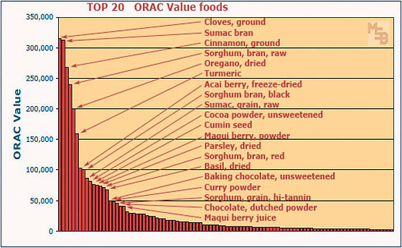
Add to Your Diet High ORAC Foods
Foods that have a high orac count have many health benefits.

Slide 78
Add to Your Diet High ORAC Foods
Foods that have a high orac count have many health benefits.
Note: This ORAC list does not factor or attempt to suggest the quantities that a person would normally eat in one serving (for example – who is going to eat 3.5 ounces of cloves in one serving??). I simply intend to point out which ‘foods’ are literally the highest in ORAC value (that I could find information about).

Slide 79
Macronutrients
Add Healthy Carbohydrates to Your Diet
Go Green, Yellow, Orange, Purple

Slide 80
Macronutrients
Macronutrients are a group of nutrients that provide your body with energy and the components it needs to maintain its structure and functions.
Macronutrients include:
Carbohydrates
Protein
Fat
They’re needed in relatively larger amounts than other nutrients, hence the term “macro.

Slide 81
Increase
Macronutrients
Macronutrients are a group of nutrients that provide your body with energy and the components it needs to maintain its structure and functions.
Macronutrients include carbohydrates, protein, and fat. They’re needed in relatively larger amounts than other nutrients, hence the term “macro.

Slide 82
A Holistic Blueprint
Customized for Your Self-Care

Slide 83
Increase
Micronutrients
The term micronutrients refers to vitamins and minerals, which can be divided into macrominerals, trace minerals and water- and fat-soluble vitamins. An adequate intake of micronutrients means eating a variety of vegetables and fruits and incorporating a balanced and diverse intake of foods.

Slide 84
The body needs macro and micronutrients and macro-minerals to support life and sustain health. Our master classes will help you learn how to eat to live and heal. The following section is on how to get adequate nutrients to support heart health.

Slide 85
Importance of minerals
Minerals have equal importance as oxygen has in our body to sustain life
Minerals are necessary to convey the message through the nervous system.
Minerals help in digestion, increase your metabolism, and utilize all nutrients in food.
Minerals help in the growth of teeth, bones, and hair.
Minerals help in the biological reaction in a body by acting as a catalyst
Minerals are needed to perform the healing process.

Slide 86
Micro or Trace Minerals include
iron
Manganese
Copper
Iodine
Zinc
Cobalt
Selenium
Macro Or Major Minerals include
Calcium
Phosphorous
Potassium
Magnesium
Sulfur
Sodium
Chloride

Slide 87
Micromineral
Iron
Iron is an important mineral that helps maintain healthy blood. A lack of iron is called iron-deficiency anemia, which affects about 4-5 million Americans yearly. It is the most common nutritional deficiency worldwide, causing extreme fatigue and lightheadedness. It affects all ages, with children, women who are pregnant or menstruating, and people receiving kidney dialysis among those at highest risk for this condition.

Slide 88
Micromineral Copper
Copper is an essential trace mineral necessary for survival. It is found in all body tissues and plays a role in making red blood cells and maintaining nerve cells and the immune system. It also helps the body form collagen and absorb iron and plays a role in energy production..
Low copper levels have been linked to high cholesterol and high blood pressure. One group of researchers suggested that some patients with heart failure may benefit from increasing copper rich foods.
Animal studies have linked low copper levels to CVD, but it remains unclear if a deficiency would have the same impact on humans.

Slide 89
Micromineral Iodine
Iodine is an element that is used by the thyroid. Humans cannot produce iodine, so it must be consumed. It is added to some foods and also to salt.
According to WebMD iodine reduces thyroid hormone and can kill fungus, bacteria, and other microorganisms such as amoebas. Iodine deficiency is one of the most common and preventable world health problems. Most iodine is found in the ocean, where it is concentrated by sea life, particularly in seaweed.

Slide 90
Micromineral Zinc
Zinc helps keep your immune system strong. Because it is necessary for immune cell function and cell signaling, a deficiency can leads to a weakened immune response . Zinc supports hormonal production and helps reduce oxidative stress.

Slide 91
Micromineral
Cobalt
Production of vitamin B12, which is essential for red blood cell formation.
Prevention of anemia.
Support of cardiovascular health.
Role in thyroid function and fertility.
Absorption of iron by the body.
Aid in the repair of myelin sheath.

Slide 92
Microminerals
Selenium
Selenium is a nutrient that the body needs to stay healthy. Selenium is important for reproduction, thyroid gland function, DNA production, and protecting the body from damage caused by free radicals and from infection.
Adults 19–50 years 55 mcg
Adults 51–70 years 55 mcg
Adults 71 years and older 55 mcg
Pregnant teens and women 60 mcg
Breastfeeding teens and women 70 mcg

Slide 93
Macro mineral
Calcium
Calcium is the most abundant mineral in the body and essential for bone health, blood clotting, muscle and nerve function.
Women need.
How much calcium you need depends on your age and sex. The recommended upper limit for calcium is 2,500 mg a day for adults 19 to 50. For those 51 and older, the limit is 2,000 mg a day.

Slide 94
Macromineral
Phosphorous
According to WebMD, phosphorous is a building block for healthy teeth and bones. You may think that's calcium's job. But calcium needs phosphorus to make your teeth and bones strong.
Phosphorus also helps your nerves and muscles do their jobs. It's a buffer that keeps the pH level in your blood balanced. Phosphorus also helps you turn fat, carbs, and protein into energy.

Slide 95
Macromineral
Potassium
Potassium is linked to many powerful health benefits. Some of the benefits of potassium include:
Healthy blood pressure
Cardiovascular health
Bone strength
Muscle strength
Fluid balance
Protects against stroke
Helping prevent osteoporosis and kidney stones.
Sulfur
Sodium
ChlorideSelenium
How much do you need daily?

Slide 96
Macromineral
Sulfur
Sulfur is an essential mineral that has various benefits for your body such as:
Building and repairing DNA and regulating gene expression.
Protecting your cells from damage and harmful microbes.
Metabolizing food and making protein.
Contributing to the health of your skin, hair, tendons, and ligaments.
Forming collagen and maintaining skin’s tone and elasticity.
Supporting bone health and preventing arthritis.
Having antioxidant properties and preventing oxidative stress.

Slide 97
Macromineral
Sodium
Sodium is needed for blood regulation and its absence
can cause serious impairment of bodily functions. It is a versatile element and occurs in more than eighty different forms. As an electrolyte, it regulates the bodily fluids and transmits electrical impulses in the body
How much do you need daily?
2400 mgs or less.

Slide 98
Macromineral
Chloride
A small percentage of about 15% of chloride in the body is located inside cells, with the highest amounts in red blood cells. Chloride is also present in very small amounts in bones.
Most of our chloride intake is from table salt. It is easily absorbed by the intestines.
Chloride is eliminated through the kidneys in a finely tuned mechanism that regulates acid-base balance by either removing or retaining chloride.

Slide 99
Magnesium
How much magnesium should you consume daily to support heart and muscle health?
Magnesium deficiency is running rampant among Americans. A study sponsored by the National Institutes of Health shows that 68% of Americans are magnesium deficient. Other experts estimate that 80% of adults are deficient.
Data from the 1999-2000 National Health and Nutrition Examination Survey suggest that substantial numbers of adults in the U.S. don’t get even the minimal amounts of magnesium recommended.
Of all the minerals required for good health, calcium has been pushed into the spotlight. There has been a flood of calcium-fortified foods, beverages, and supplements. Ironically, without magnesium, calcium cannot be properly used or absorbed by the body.

Slide 100
Magnesium
Magnesium is needed for more than 300 biochemical reactions in the body. It helps to maintain normal nerve and muscle function, supports a healthy immune system, keeps the heartbeat steady, and helps bones remain strong. It also helps adjust blood glucose levels.

Slide 101
According to the Physician’s Desk Reference, these common drugs can create a magnesium deficiency:
Common diuretics and cardiac drugs
Birth control pills
Insulin
Digitalis
Tetracycline and other antibiotics
Cortisone

Slide 102
Dry roasting nuts removes the highly nutritious oils which contain magnesium.
Milling flour from grains strips magnesium from the grain.
White sugar increases the release of magnesium.
Fluoridated, softened, and distilled water depletes magnesium.
Carbonated beverages and some processed foods, like lunch meat, contain phosphates that bind to magnesium molecules and flush it out of the body.
Alcohol blocks magnesium, especially if you have three or more drinks a day.
Coffee works like a diuretic to flush magnesium from of the body.
Some foods—like raw or roasted nuts and seeds, soybeans, spinach, and chard—contain compounds called phytic acid and oxalic acid which can cause magnesium to be eliminated from the body.

Slide 103
Potassium
Potassium is a mineral found in the foods you eat. It’s also an electrolyte. Electrolytes conduct electrical impulses throughout the body. They assist in a range of essential regulation:
•blood pressure
•normal water balance

Slide 104
Omega 3
Omega-3 fatty acids are important fats that provide many health benefits.
Studies have found that they may reduce inflammation, decrease blood triglycerides, and even reduce the risk of dementia.

Slide 105
Omega 3
The most well-known sources of omega-3 fatty acids are fish oil and fatty fish such as salmon, trout, and tuna.
This can make it challenging for vegans, vegetarians, or even those who simply dislike fish to meet their omega-3 fatty acid needs.

Slide 106
Plant-Based Omega 3 Sources
Chia seeds
Chia seeds are known for their many health benefits, providing a hefty dose of fiber and protein in each serving.
They’re also a great plant-based source of ALA omega-3 fatty acids.
Studies have found that, thanks to their omega-3, fiber, and protein, chia seeds could decrease the risk of chronic disease when consumed as part of a healthy diet.

Slide 107
Plant-Based Omega 3 Sources
Brussels sprouts
In addition to their high content of vitamin K, vitamin C, and fiber, Brussels sprouts are an excellent source of omega-3 fatty acids.

Slide 108
Plant-Based Omega 3
Algal oil
Algal oil, a type of oil derived from algae, stands out as one of the few vegan sources of both EPA and DHA (14Trusted Source).
Some studies have even found that it’s comparable to seafood in regard to its nutritional availability of EPA and DHA.
One study compared algal oil capsules to cooked salmon and found that both were well tolerated and equivalent in terms of absorption.

Slide 109
Plant-Based Omega 3
Hemp Seed
In addition to protein, magnesium, iron, and zinc, hemp seeds consist of about 30% oil and contain a good amount of omega-3s.
Studies have found that the omega-3s found in hemp seeds could benefit heart health. They may do this by preventing the formation of blood clots and helping the heart recover after a heart attack.
Three tablespoons (30 grams) of hemp seeds contain approximately 2,600 mg of ALA

Slide 110
Plant-Based Omega 3
Walnuts
Walnuts are loaded with healthy fats and ALA omega-3 fatty acids. In fact, walnuts are composed of about 65% fat by weight (21Trusted Source).
Several animal studies have found that walnuts could help improve brain health as a result of their omega-3 content.
Studies in both humans and animals have found that eating walnuts is associated with improvements in cognitive performance and memory.

Slide 111
Perilla oil
This oil, derived from perilla seeds, is often used in Korean cuisine as a condiment and cooking oil. In addition to being a versatile and flavorful ingredient, it’s a good source of omega-3 fatty acids.
In one study in 20 elderly participants, researchers replaced soybean oil with perilla oil and found that it caused ALA levels in the blood to double. In the long term, it also led to an increase in EPA and DHA blood levels. Perilla oil is very rich in omega-3 fatty acids, with ALA making up an estimated 64% of this seed oil.
Each tablespoon (14 grams) contains nearly 9,000 mg of ALA omega-3 fatty acids.
Perilla oil is also available in capsule form for an easy and convenient way to increase your omega-3 intake

Slide 112
Plant-Based Omega 3
Walnuts
Walnuts are loaded with healthy fats and ALA omega-3 fatty acids. In fact, walnuts are composed of about 65% fat by weight (21Trusted Source).
Several animal studies have found that walnuts could help improve brain health as a result of their omega-3 content.
Studies in both humans and animals have found that eating walnuts is associated with improvements in cognitive performance and memory.

Slide 113
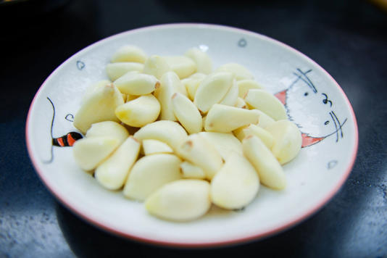
Foods That Supports Healthy Circulation
Garlic
Garlic is loaded with several essential compounds that may potentially benefit your overall cardiovascular health. It is rich in sulfur compounds, which may enhance blood flow and thin blood as well. Regular consumption of garlic may also improve the production of nitric oxide in the blood vessels, which may further reduce diastolic and systolic blood pressure.

Slide 114
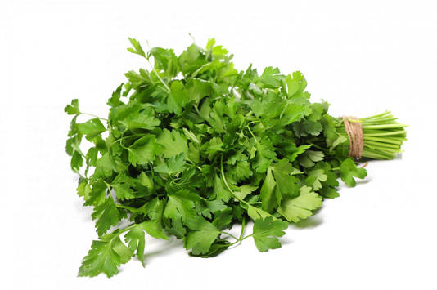
Foods That Supports Healthy Circulation
Parsley
Parsley is also among some beneficial herbs good for high blood pressure. It is rich in compounds like vitamin C and carotenoids, which may help manage high blood pressure.
Studies suggest that antioxidants like carotenoids reduce bad cholesterol and blood pressure, both of which are major risk factors for heart problems

Slide 115
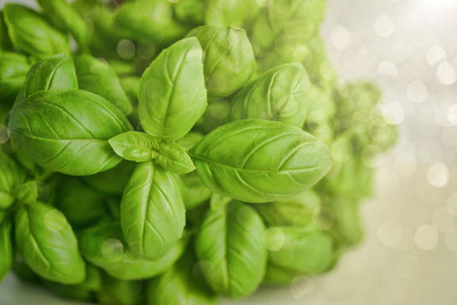
Foods That Supports Healthy Circulation
Basil
Basil is considered one of the best herbs for high blood pressure as its rich in eugenol – a plant-based antioxidant that has been linked to several health advantages, including lowered blood pressure.
According to many studies, eugenol reduces blood pressure by working as a natural calcium channel blocker in the body. Medical experts believe that calcium channel blockers limit the movement of calcium in the arterial cells and heart, thereby helping the blood vessels to relax.

Slide 116
Foods That Supports Healthy Circulation and Blood Pressure
Celery
Celery is also a great herb to reduce blood pressure as it is quite popular for its diuretic and blood pressure-lowering properties. This herb works by getting rid of excessive sodium and tissue fluid from the body, which further reduces an average blood pressure.

Slide 117
SALT
How much is to much?
While salt makes food taste good, too much can lead to health problems.
Salt affects blood pressure via several complex pathways that affect your body’s hormonal, inflammatory, immune, and digestive systems.
In a 2016 analysis of 4 large studies including 113,118 people with and without hypertension, the risk of heart disease and death was higher in those who had a high sodium intake, compared with those with a moderate sodium intake.

Slide 118
SALT
How much is to much?
High salt foods include bread, salty snacks, soups, processed meats, cheese, and some desserts. Check the packaging and nutrition labels of packaged foods to choose low sodium options.
The American Heart Association (AHA) advocates that adults get fewer than 2,300 mg of sodium per day, optimally aiming for 1,500 mg, which equals 3/4 teaspoon of salt.
Despite this advice, the average American consumes 1.5 teaspoons of salt each day, which exceeds the recommended intake.

Slide 119
White Sugar
How much is to much?
Large studies have found links between added sugars and common chronic conditions such as high blood pressure, obesity, diabetes, and heart disease, elevated triglycerides, low HDL (good) cholesterol, cancer, and dementia.
Some of the sugars you eat come from naturally occurring sources in whole foods that are good for you. According to the Dietary Guidelines for Americans, nearly 70% of added sugars come from these five types of food and drink: • sweetened beverages such as colas • desserts and sweet snacks • sugar-sweetened coffee and tea drinks • candy • breakfast bars and cereals.

Slide 120
Perhaps you have heard about eating based on you blood type. While there are well documented correlations between your blood type and food tolerance, and we encourage you to know your blood type, R & R takes you further into understanding how to eat to affect blood chemistry. Your blood type is static whereas your blood chemistry is fluid.
If your cholesterol level is high and putting you at risk for artery disease, you blood type is not an indicator of your risk. However, if you know your blood chemistry it will indicate your risk and degree of risk. We will coach you on the significance of the hand -picked blood chemistry tests we have selected. They are that

Slide 121
Perhaps you have heard about eating based on you blood type. While there are well documented correlations between your blood type and food tolerance, and we encourage you to know your blood type, R & R takes you further into understanding how to eat to affect blood chemistry. Your blood type is static whereas your blood chemistry is fluid.
If your cholesterol level is high and putting you at risk for artery disease, you blood type is not an indicator of your risk. However, if you know your blood chemistry it will indicate your risk and degree of risk. We will coach you on the significance of the hand -picked blood chemistry tests we have selected. They are that

Slide 122
Blood Chemistry Tutorial
VIDEO

Slide 123
Customize Your Blueprint

Slide 124
Now that you have your blood tests, health assessment and journal, DISH4LIFE will guide you on customizing a holistic blueprint to reset your heart health and wellness experience.
DISH4LIFE has a collection of menus and whole foods that anyone can use to create delicious and nutritious meals. However, we will coach you on how to modify your lifestyle and eat foods that can restore, revitalize, and boost the body’s healing and protection mechanisms.
DISH4LIFE has a rich sources healing dishes that are backed by science which include the Mediterranean, plant-based (vegan and vegetarian menus. Based on your blood chemistry, we design your customizes wellness blueprint using micronutrients (vitamins and minerals) to support your specific needs.

Slide 125
R & R cannot guarantee any specific health outcomes, however, CDC, WHO, NIH, and research institutions concur that broken hearts are identifiable, manageable, and preventable, and that food can heal and make you sick. And by applying the science-based recommendations described in our subscriptions, you can reset your heart’s
health and overall wellbeing by learning how to safely and effectively reducing many risk factors.

Slide 126
CONGRATULATIONS YOU HAVE COMPLETED
LEVEL 1
MEASURE YOUR PROGRESS

